Slide 1
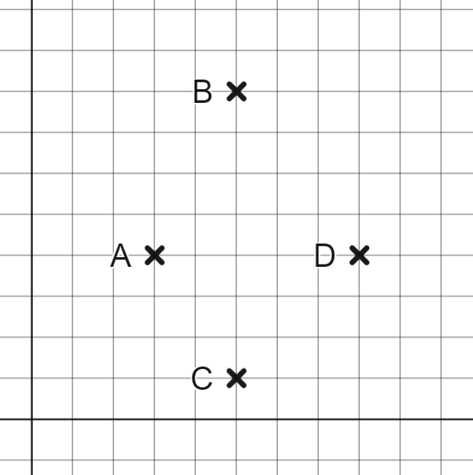
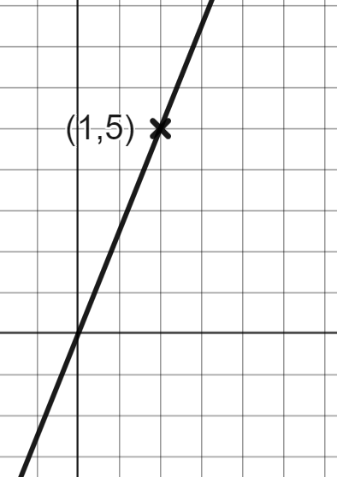
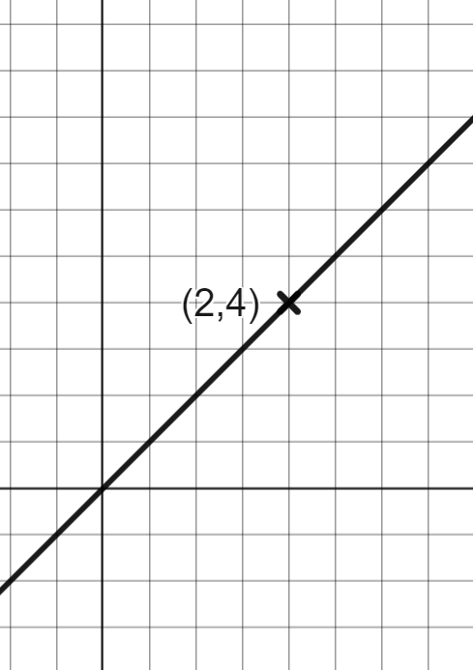
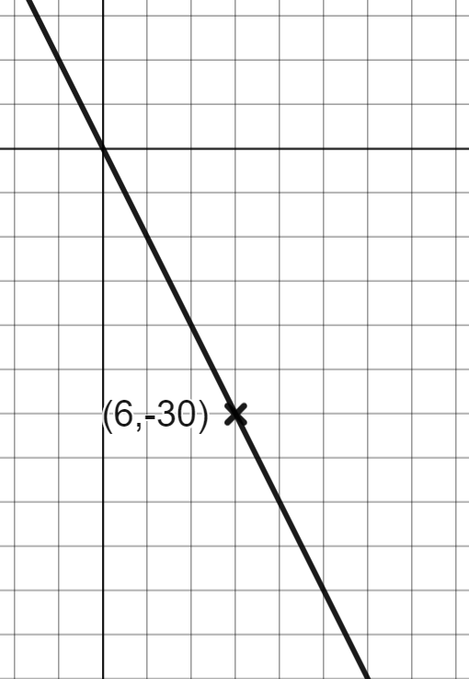
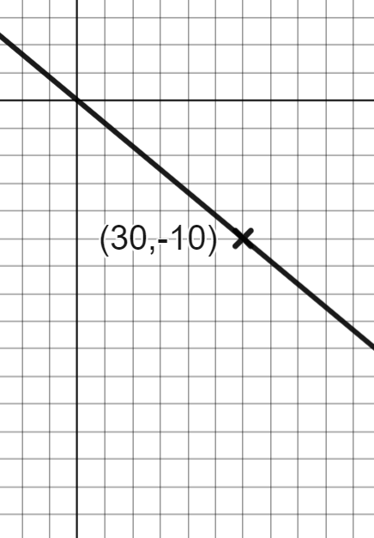
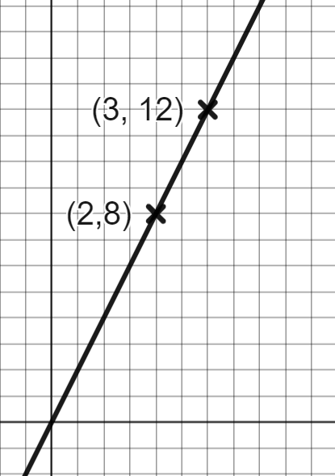
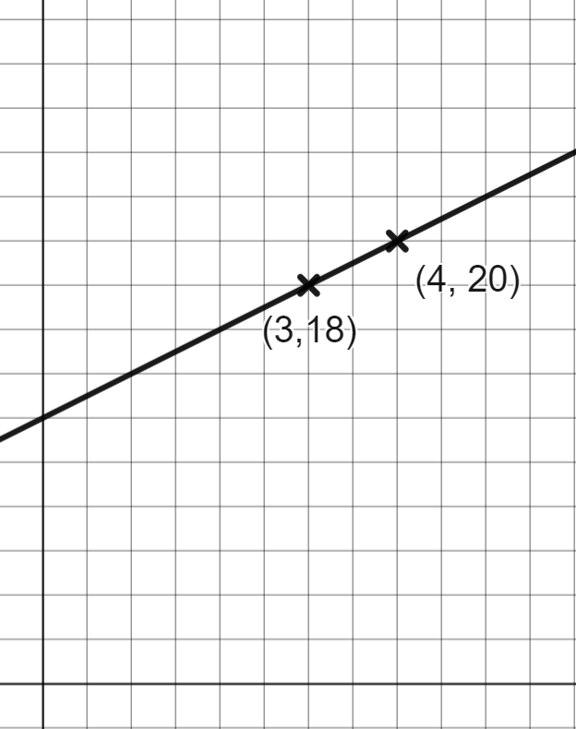
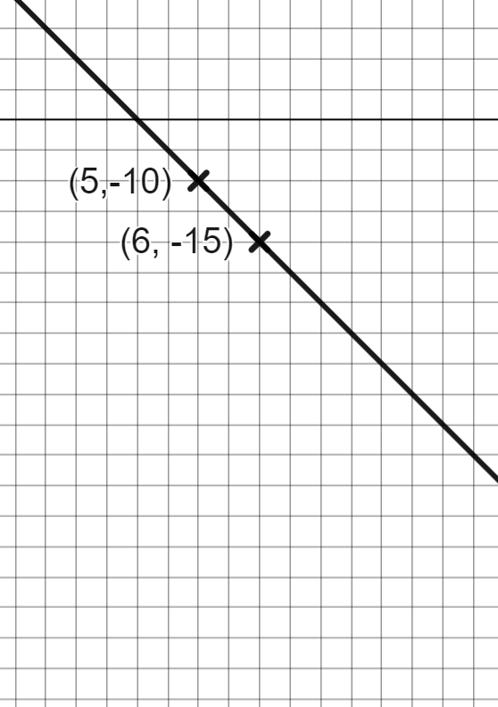
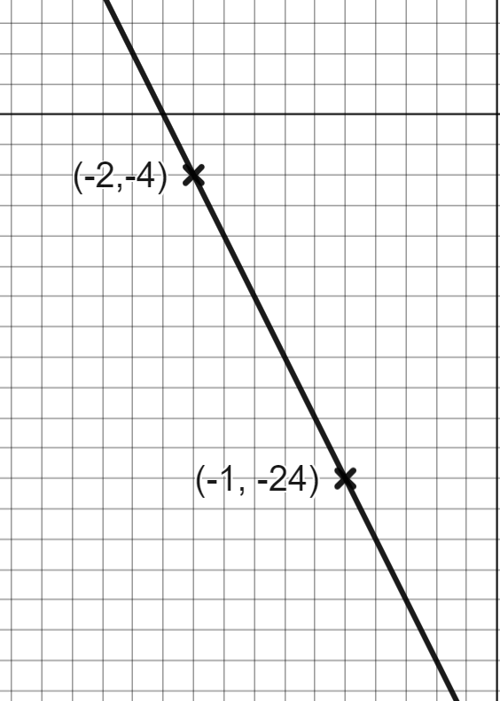
Rate of change from a coordinate pair
Task A: Reading the axes accurately to calculate gradient
1) The points A, B, C and D have been plotted on the same axes.
Which is steeper
A to B or C to D?
A to C or B to D?
A to B or A to C?
Where could you move the coordinate, D, to make this shape a parallelogram?
2) Calculate the gradient of each line

Slide 2
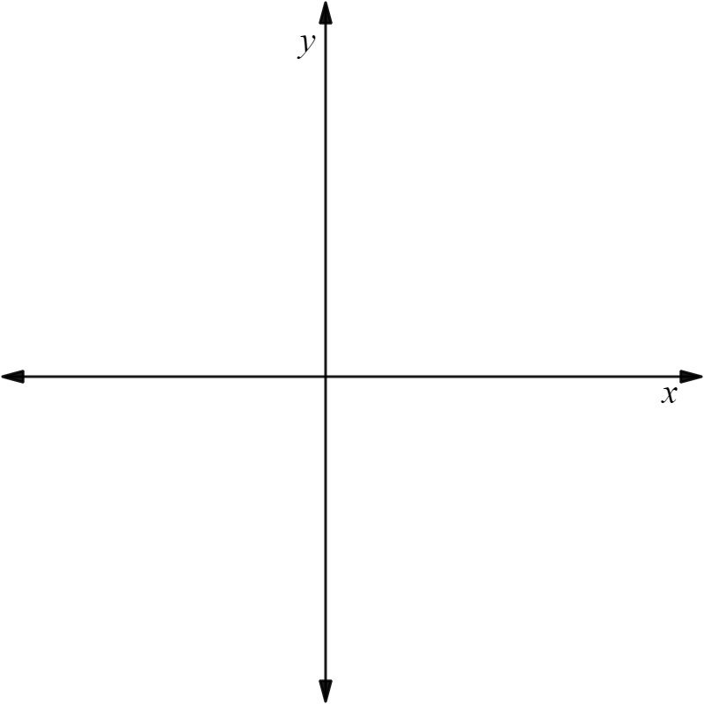
Rate of change from a coordinate pair
Task B: Calculating gradient from coordinate pairs
1) Find the gradient of the line joining the 2 coordinates given. You may use the axis to help
a) (7,8) and (4,2) | b) (−1,8) and (1,2) | c) (−1,−2) and (1,10) | d) (3,−2) and (−5,10)
2) In each question, decide which line will be steeper
a) The line joining (0,0) and (5,7) or the line joining (0,0) and (5,−4)
b) The line joining (0,0) and (3,4) or the line joining (0,0) and (6,7)
c) The line joining (1,2) and (2,5) or the line joining (5,1) and (6,5)
d) The line joining (−4,4) and (5,−4) or the line joining (2,−1) and (11, −8)

Slide 3
Rate of change from a coordinate pair
Task C: Coordinates that lie on a straight line
1) By testing the gradient. See whether each set of 3 points lie on a straight line.
(1,2), (2,6) and (4,12)
(2,−8), (6,−4) and (13,3)
(0,9), (2,5) and (5,−1)
(−5, 0), (−3,−4) and (3,−8)
Mathematics in Education and Industry
v2.2

